Slide 1



Symbolic Computation use BigData Final Project
Neresha Miller
Collins Onokala
CTEC 298
Professor Bemley

Slide 2

Introduction
CTEC 298 final project, our group applied all the skills learned during the span of 7 weeks. Such as Python, visualizations, data cleaning, and tools that are used in data science. Each member worked on their respective datasets using the same techniques such as the six-visualization plot and explaining each one.

Slide 3
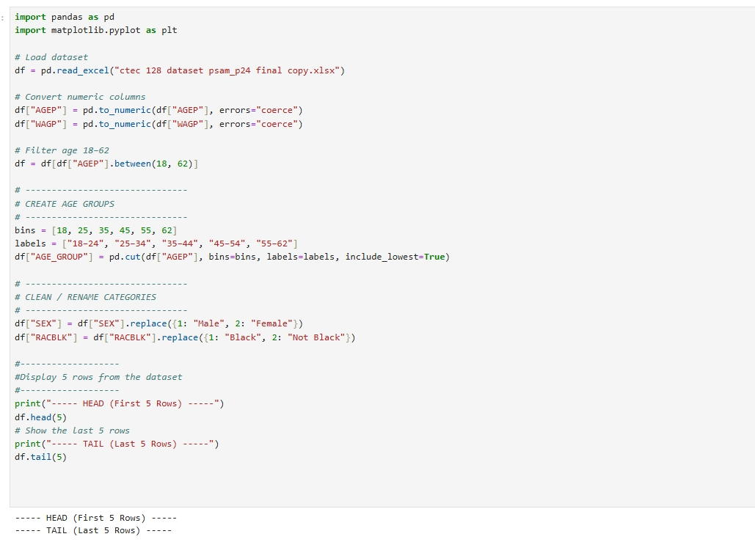
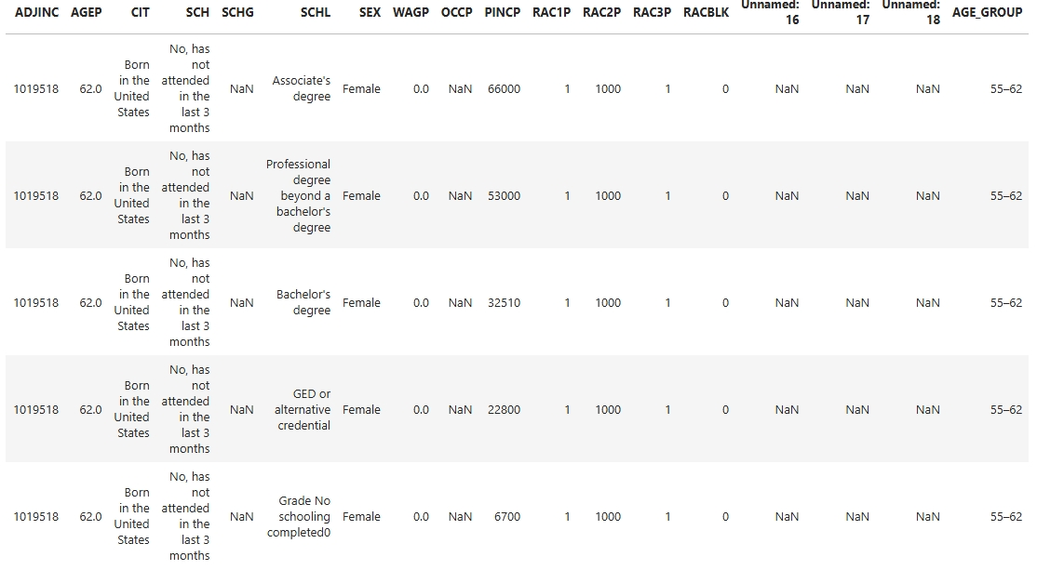
Neresha Miller Dataset
The dataset I used for this project comes from the United States Census Bureau’s Public Use Microdata Sample (PUMS). The specific dataset I worked with is the Maryland PUMS file, which includes detailed demographic, economic, and social information about residents living in the state of Maryland. This file contains a selection of important variables that describe Maryland residents ages 18 to 62.
The key data fields I focused on include AGEP (age), SEX (gender), RACBLK (Black race indicator), WAGP (income/wages), SCHL (education level), and OCCP (occupation code)

Slide 4
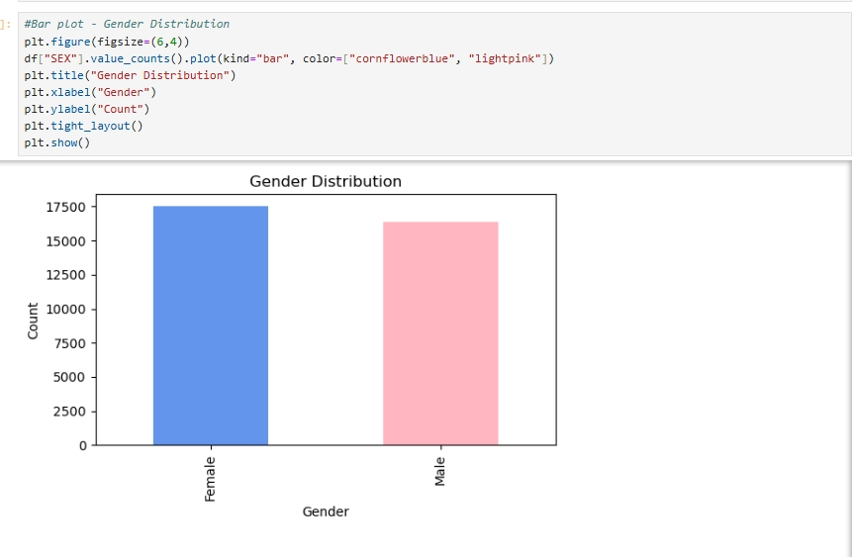
Bar Plot
This bar chart shows the number of males and females in the dataset after we filtered ages 18 to 62. By converting the numeric gender codes into clear labels (“Male” and “Female”), we can easily compare the sizes of the two groups. The bar chart makes it clear which gender has the higher representation in the sample

Slide 5
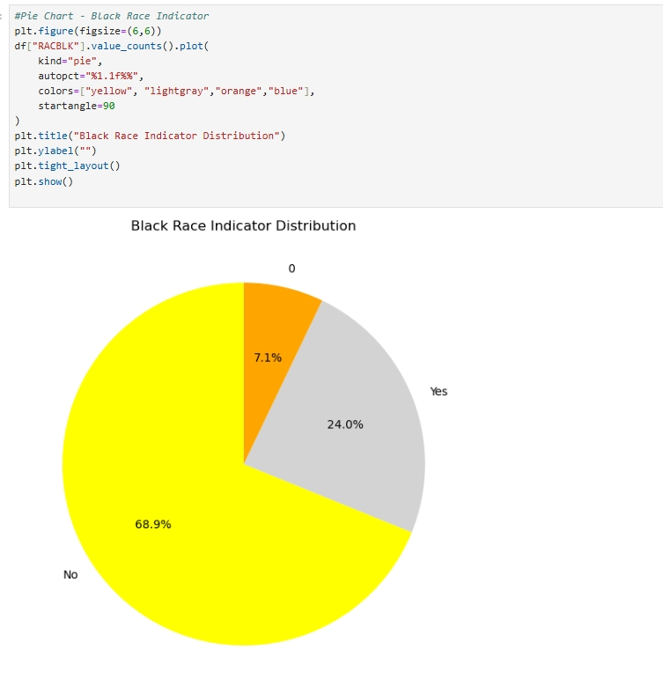
Pie Chart
The pie chart visualizes the racial indicator variable in a simple way by showing the percentage of individuals who are marked as Black versus Not Black. Because it uses proportions rather than counts, the chart helps us quickly understand what share of the dataset belongs to each racial group
Displays the percentage of individuals who identify as Black.
autopct shows the percentage on the chart.

Slide 6
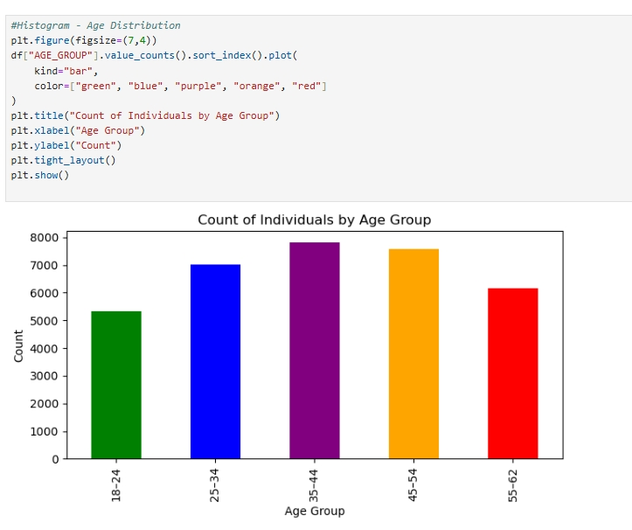
Histogram
This bar chart displays how many individuals fall into each of our created age groups: 18–24, 25–34, 35–44, 45–54, and 55–62. By creating age bins, we simplify a continuous age variable into meaningful categories. The plot helps us understand which age ranges are most common in the dataset. This is useful for interpreting occupation and income patterns later, because certain age groups may be more likely to be in school, early career, mid-career, or nearing retirement.

Slide 7
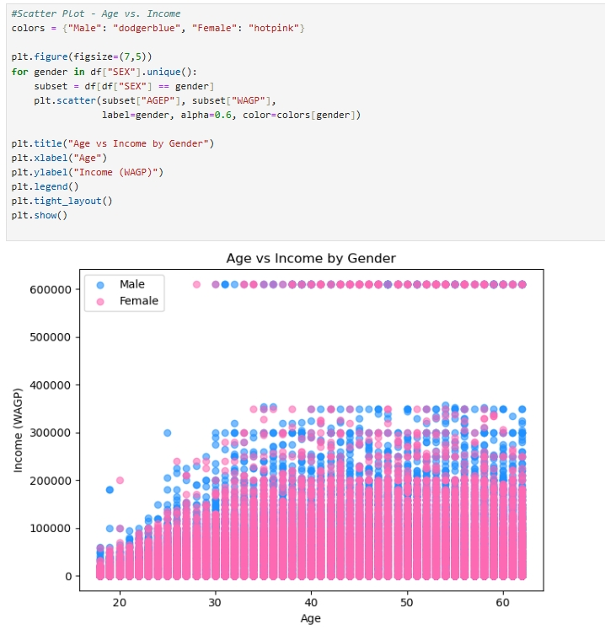
Scatter Plot
This scatter plot shows the relationship between age and income while also comparing patterns by gender. Each point represents one person, with the position showing their age and wage, and color indicating gender. This plot helps reveal trends such as whether income tends to rise with age, whether there is a noticeable difference between male and female earnings, and how much variability exists within age ranges.

Slide 8
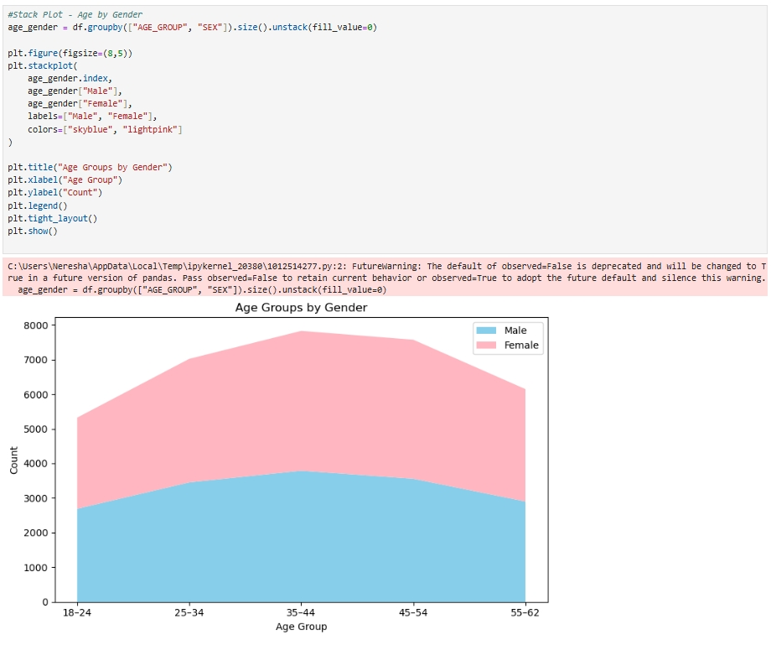
Stack Plot
The stack plot shows how males and females are distributed inside each age group. Instead of looking at total counts separately, this plot stacks them so we can easily compare their contributions within each category. This is helpful for understanding demographic imbalances. For example, some age groups may have more men than women or vice versa. This visualization makes it clear whether gender representation is consistent across age ranges or if certain age groups are dominated by one gender.

Slide 9
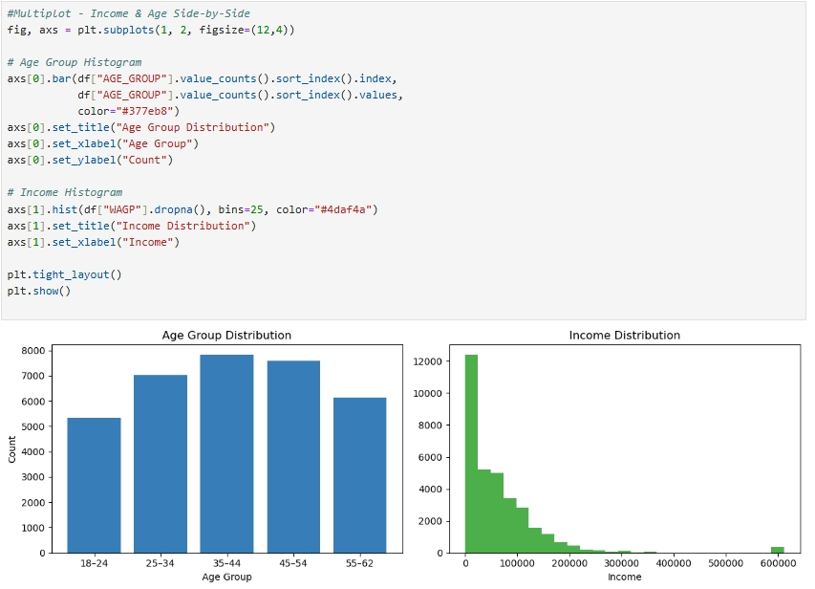
Multiplot
The multiplot contains two separate visualizations. The first panel is a bar chart that shows the distribution of individuals across age groups, which reinforces the earlier age-group visualization but in a different layout for comparison. The second panel is a histogram showing the distribution of incomes. This helps identify whether income is evenly spread or skewed, and whether most individuals earn lower, middle, or higher wages. Together, the two plots provide a deeper look at how demographics and income relate in the dataset.

Slide 10
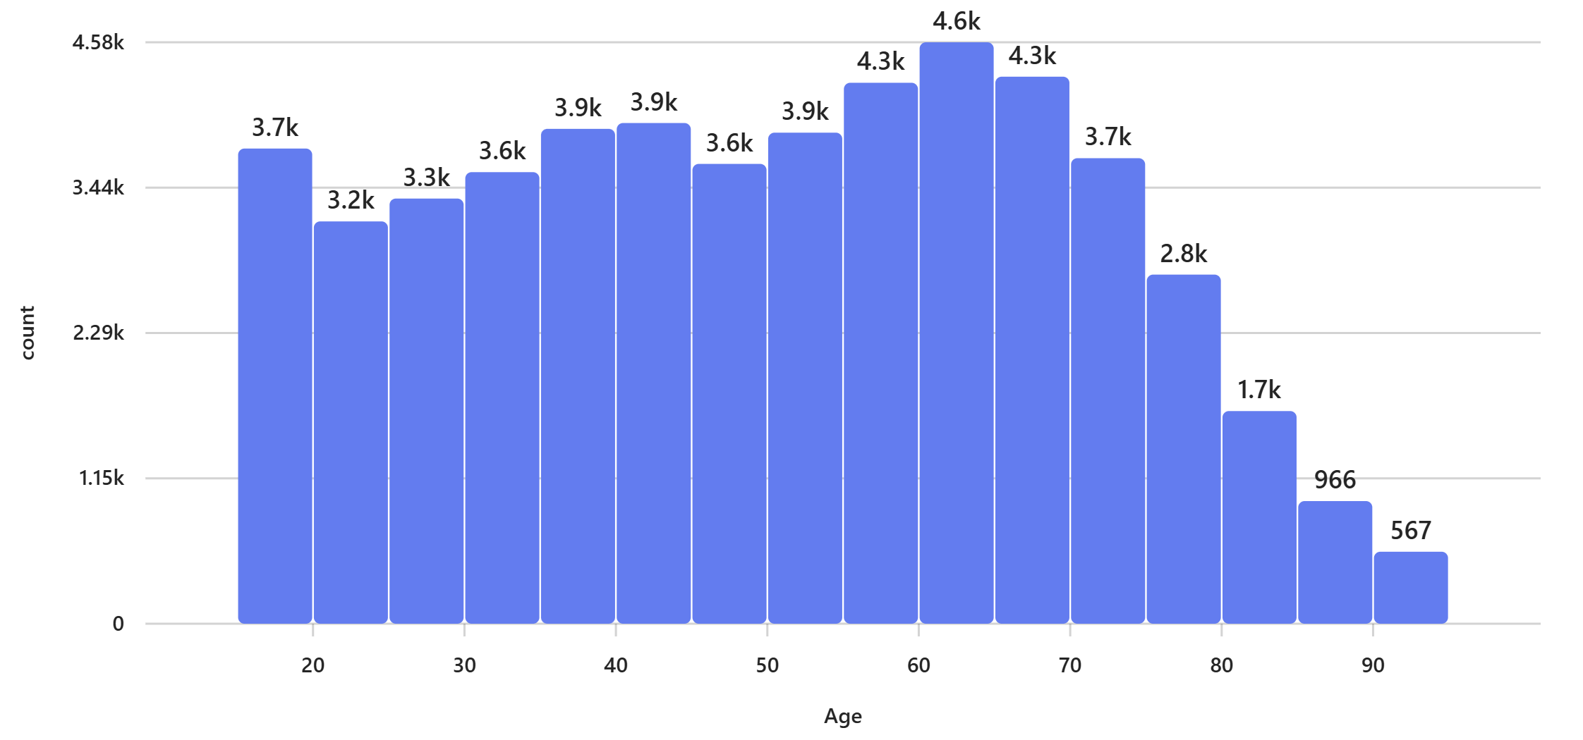
Tableau
This histogram shows the distribution of AGEP (age) in your dataset. It helps identify the most common age ranges and the overall spread of ages. dataset. Taller bars indicate higher average wages.

Slide 11
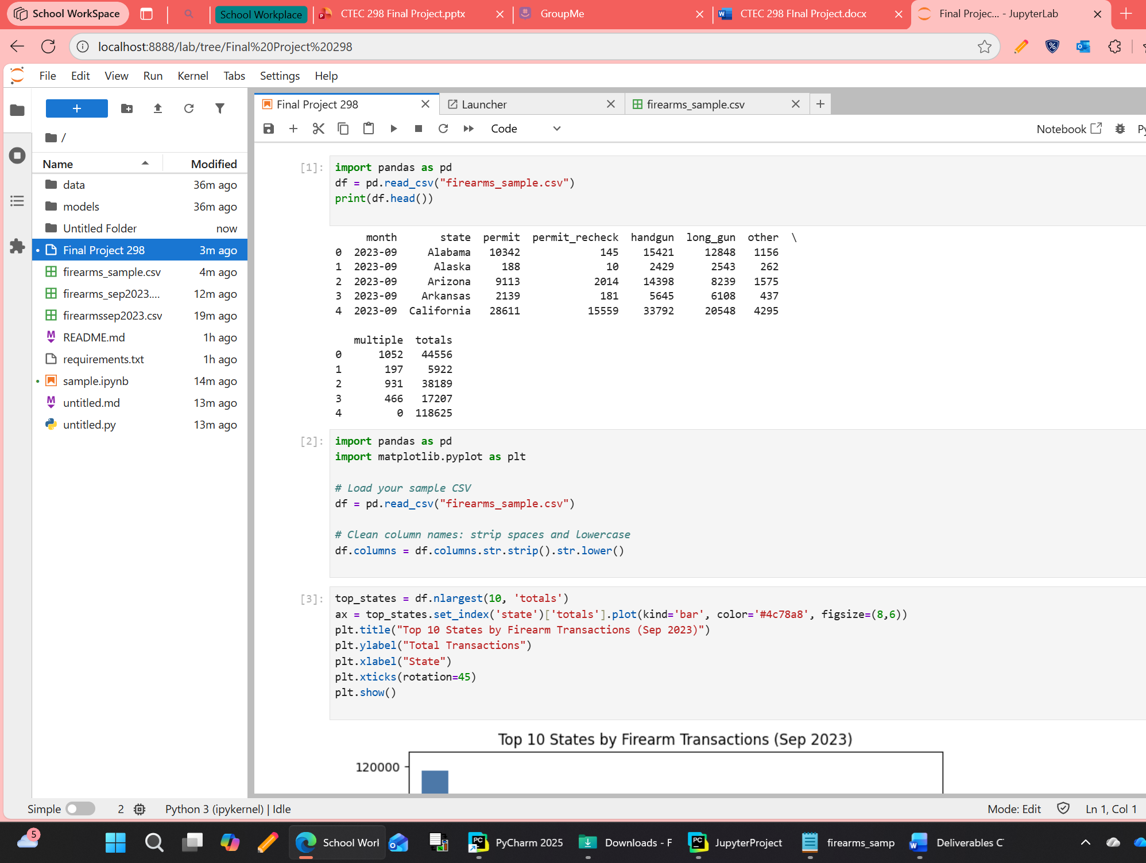
Collins onokala' Dataset
This dataset represents firearm background check transactions from September 2023. Each row shows a state and the counts of different categories such as permits, handguns, long guns, other types, and multiple firearm purchases.
The totals column adds these categories together, giving us a clear picture of overall firearm activity by state.

Slide 12
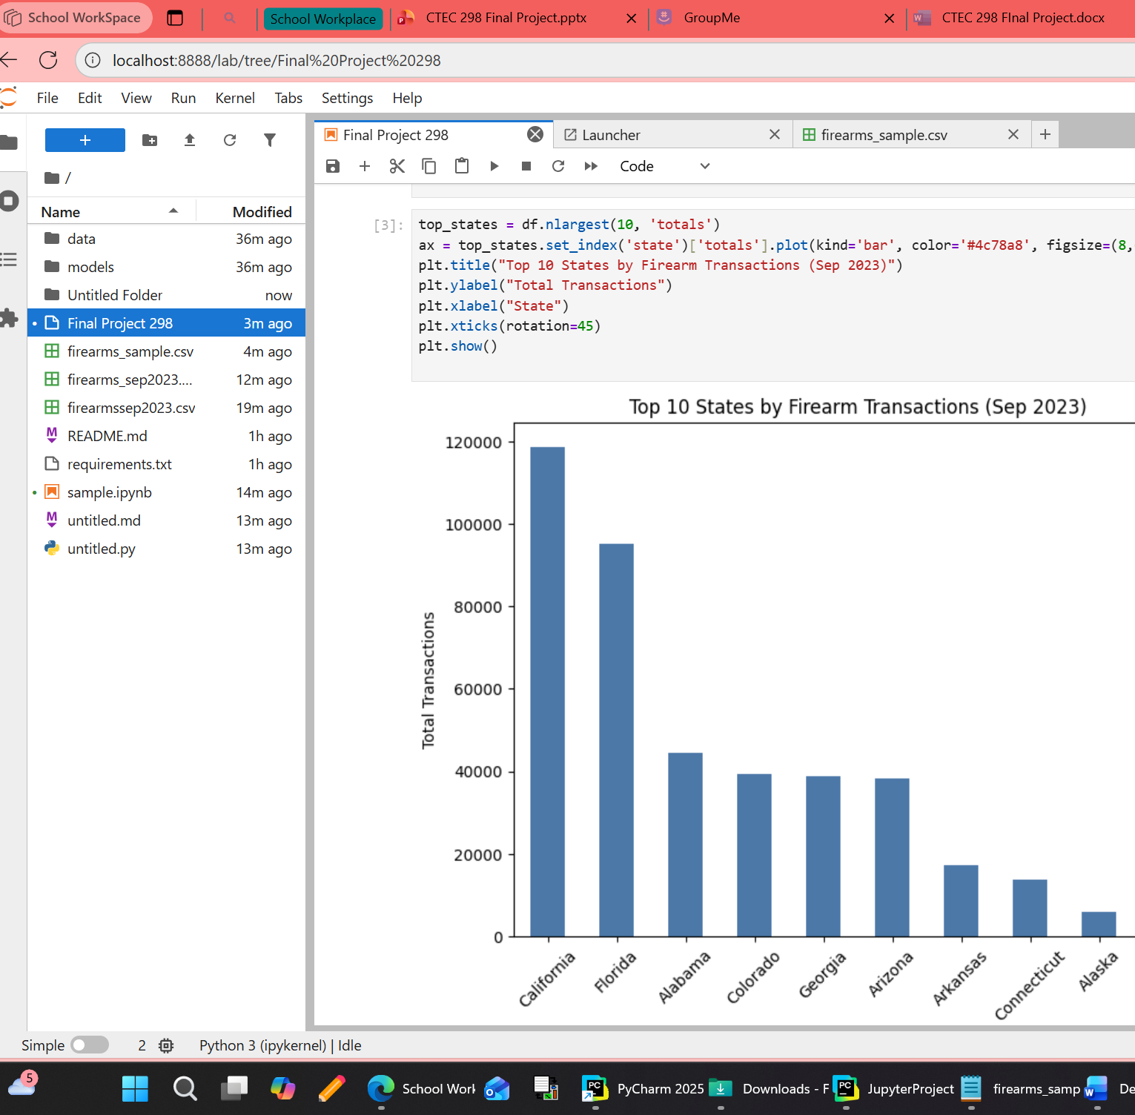
Bar plot
The bar plot highlights the states with the highest number of firearm transactions. It makes it easy to compare states side by side and see which ones stand out.
For example, California and Florida show significantly higher totals compared to smaller states, which suggests regional differences in firearm activity.

Slide 13
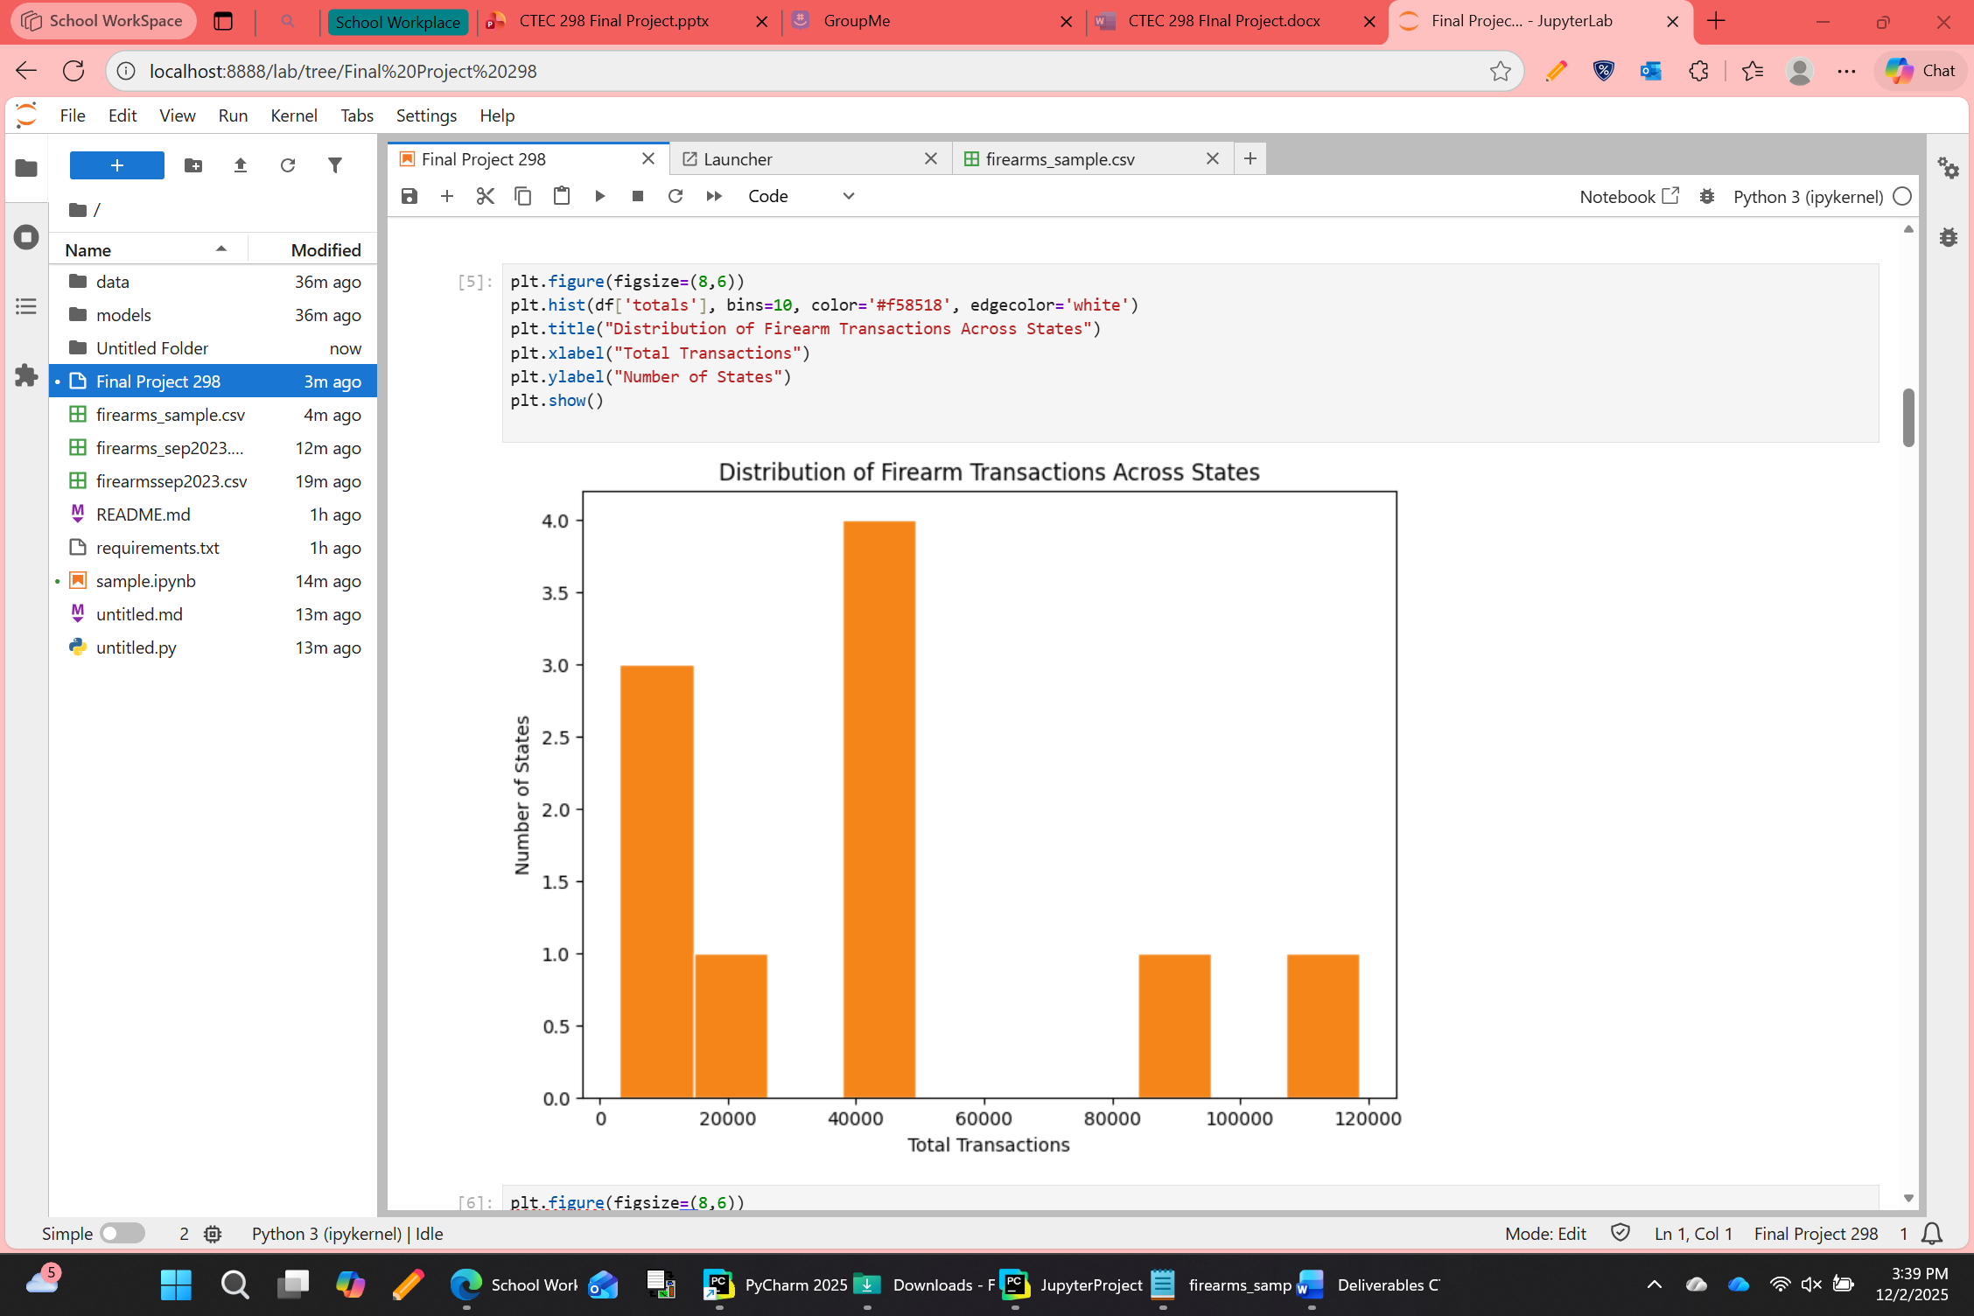
Stack plot
The stack plot shows how different categories of firearms contribute to the totals in each state. Each colored band represents handguns, long guns, other, or multiple purchases stacked together.
This visualization helps us see whether a state’s transactions are dominated by one type of firearm or spread across several categories.

Slide 14
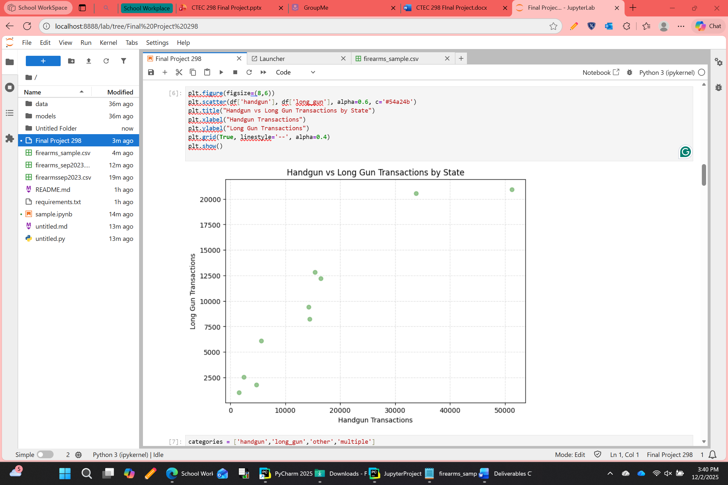
Scatter plot
The scatter plot compares handgun transactions to long gun transactions for each state. Each point represents a state, and its position shows the balance between the two categories.
States that fall along the diagonal line have similar levels of handgun and long gun activity, while outliers reveal states with unusual patterns.

Slide 15
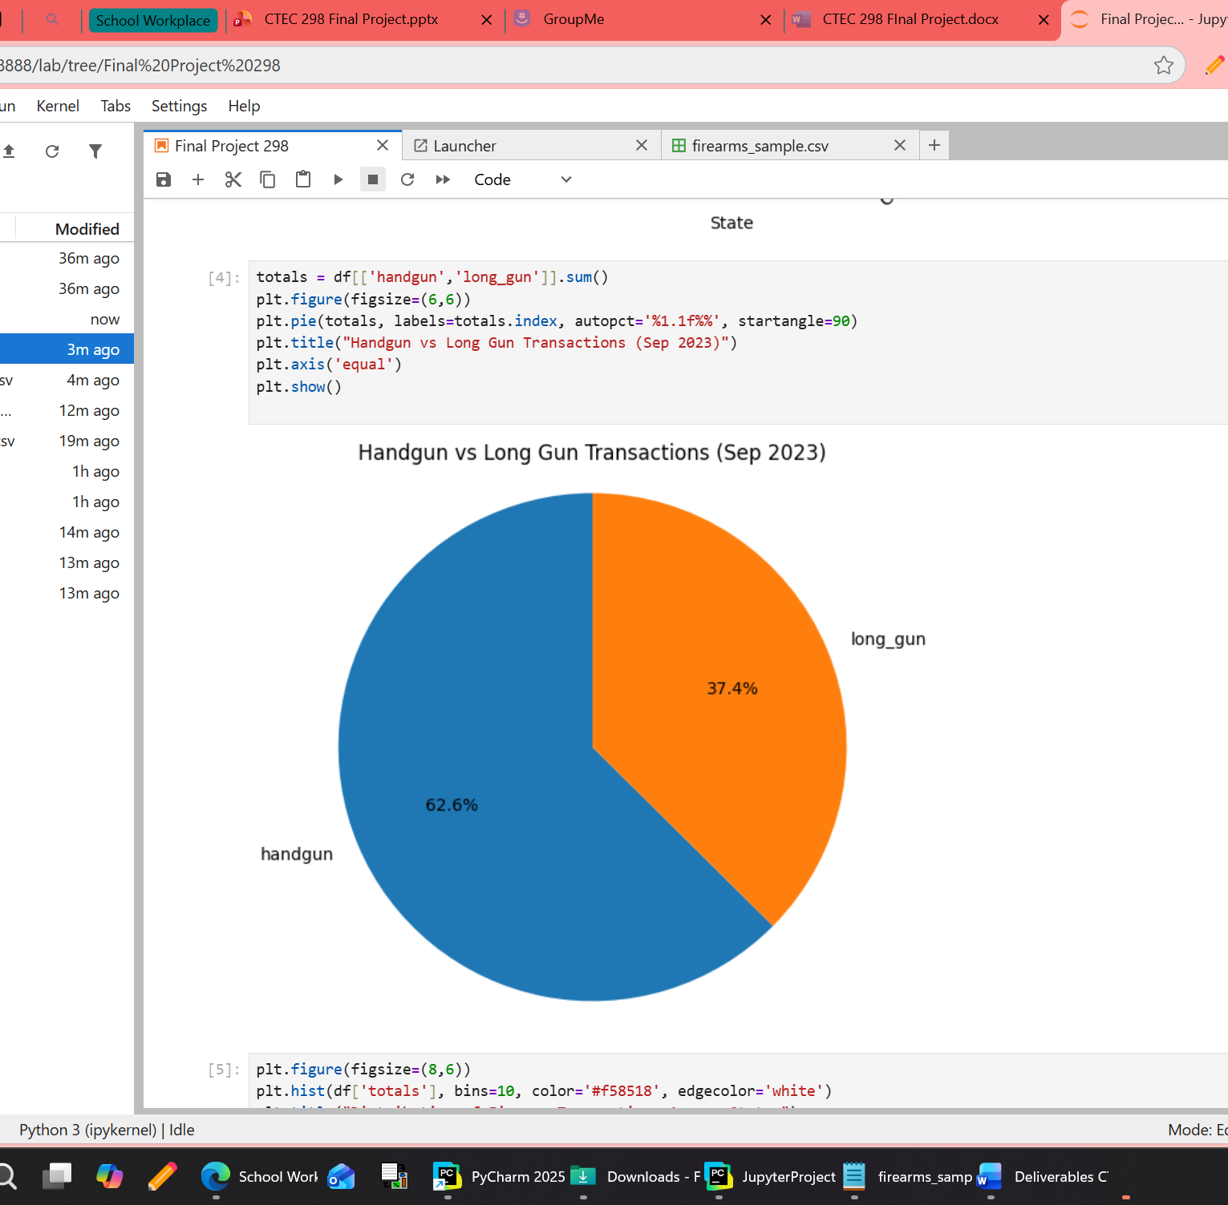
Pie chart
The pie chart summarizes the overall proportion of handgun versus long gun transactions across all states. It shows that handguns make up the majority of transactions, while long guns account for a smaller share.
This simple visualization helps the audience quickly grasp the nationwide distribution between the two categories.

Slide 16
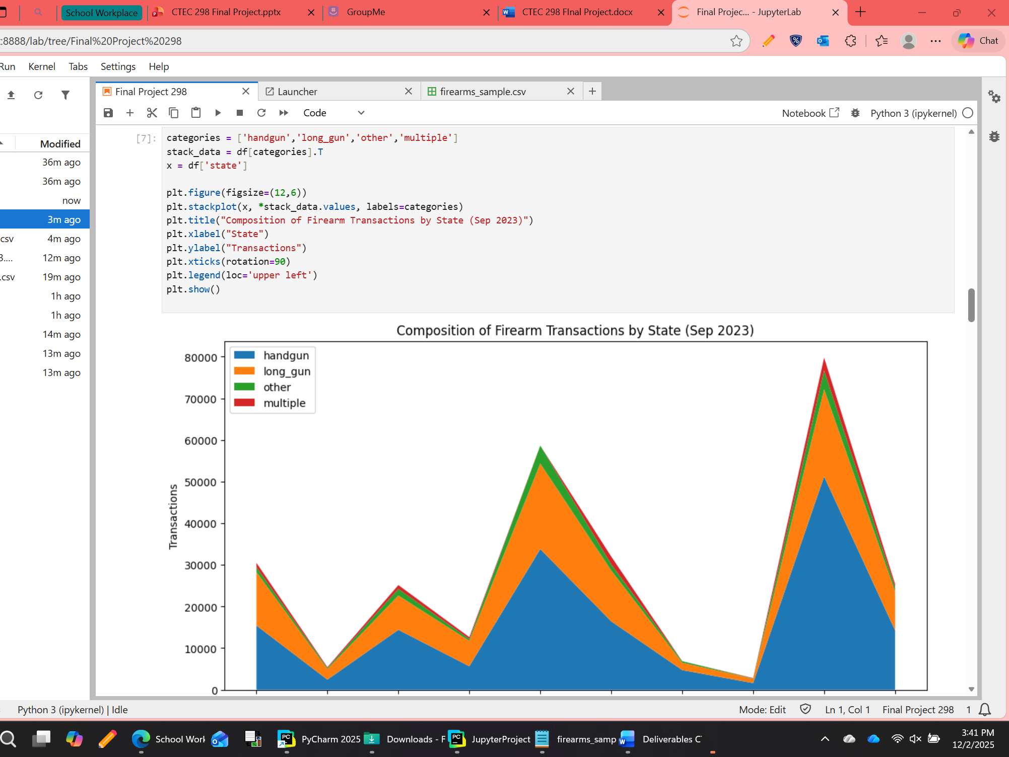
Histogram
The histogram shows how states are distributed based on their total number of transactions. Most states fall into the mid‑range, with only a few reaching very high totals.
This tells us that firearm activity is concentrated in certain states, while the majority have moderate levels of transactions.

Slide 17
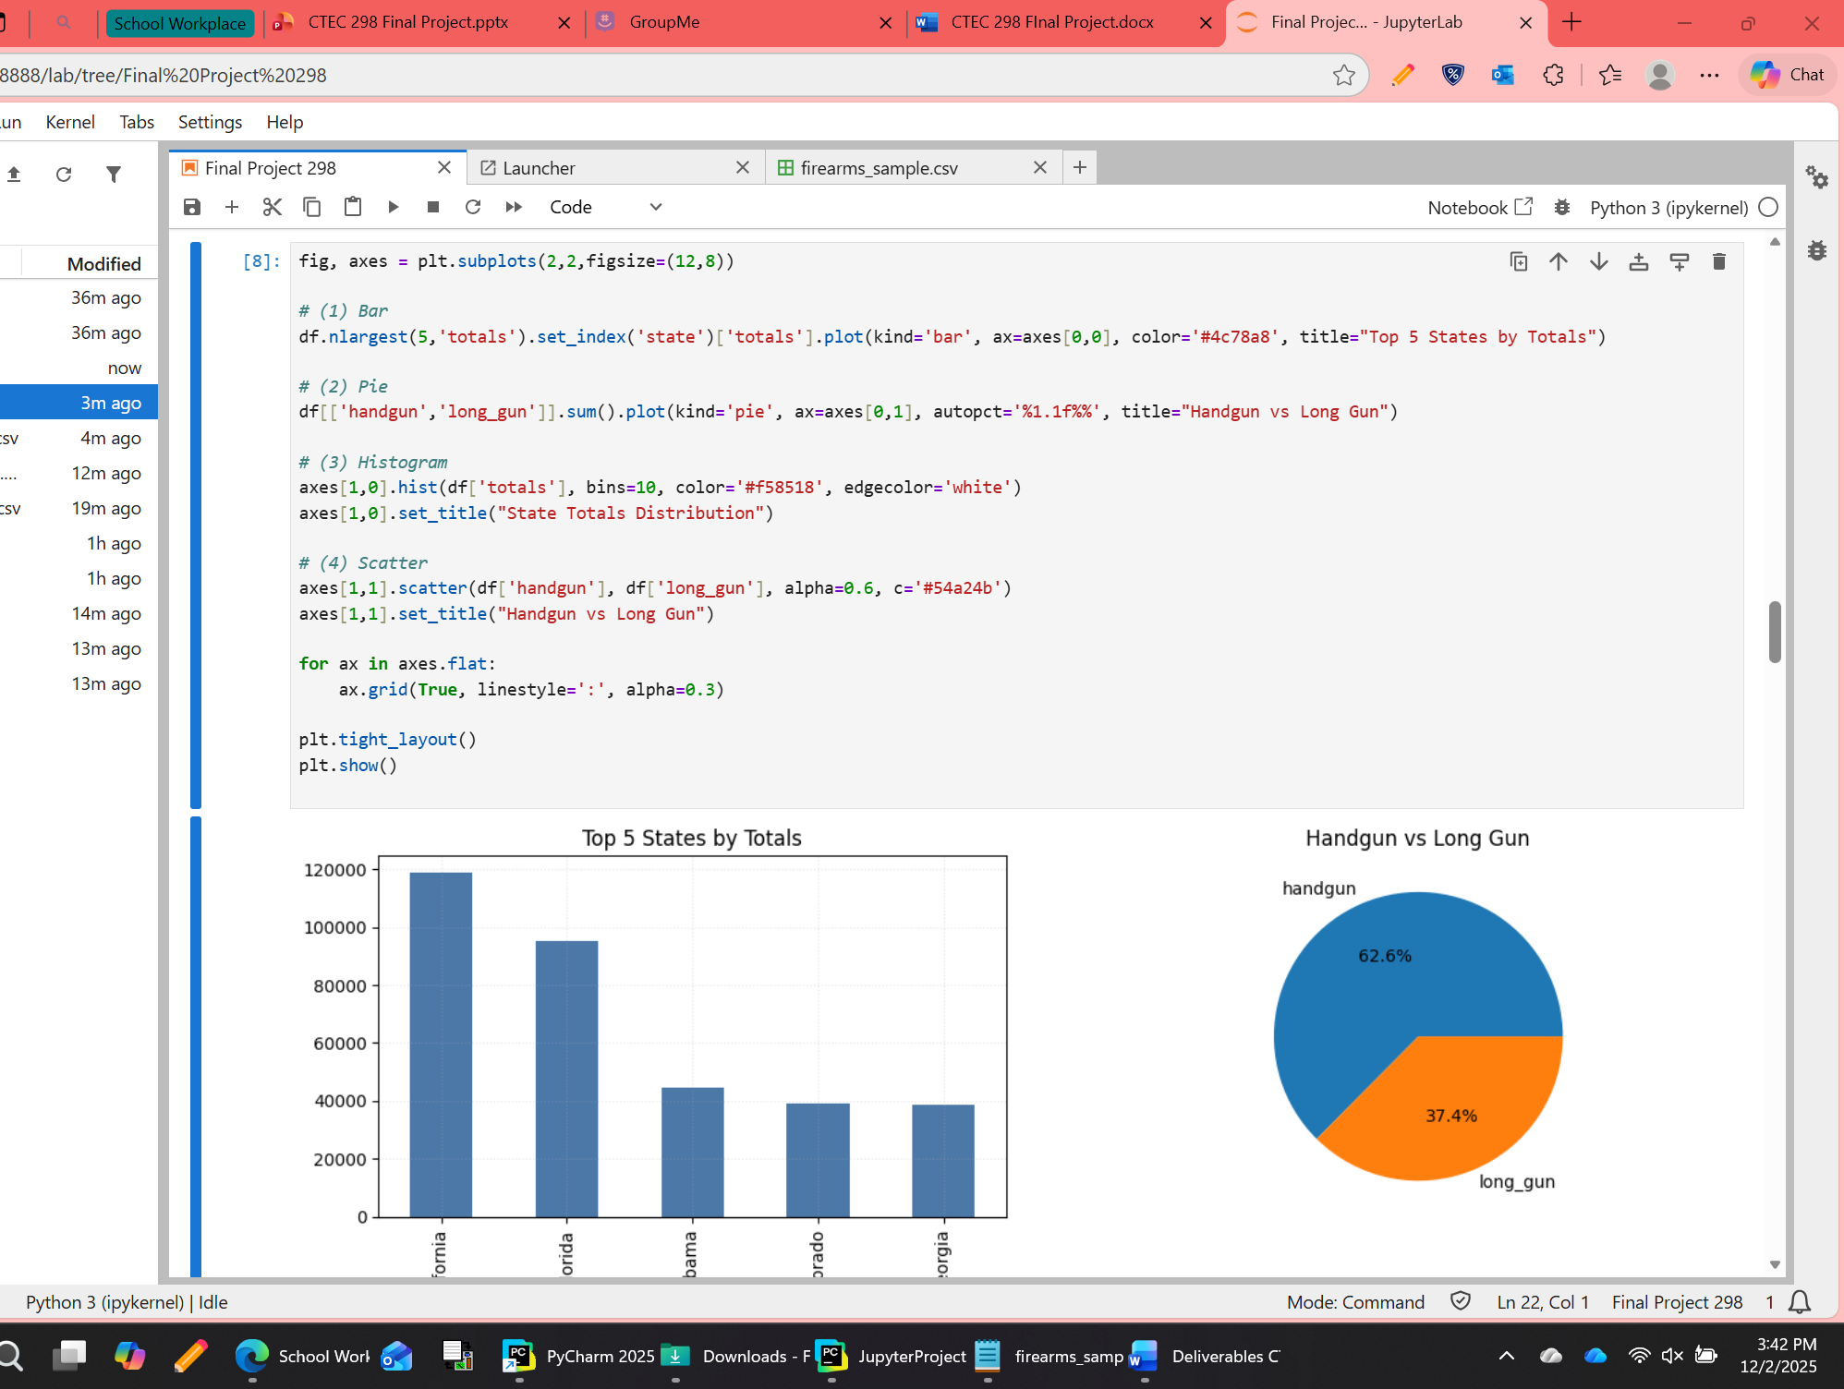
multiplot
The multiplot combines several graphs into one dashboard, giving a comprehensive overview of the dataset. It includes a bar chart, pie chart, histogram, and scatter plot all in one place.
This layout allows us to see both the big picture and the detailed relationships at the same time, making it a powerful summary slide.

Slide 18
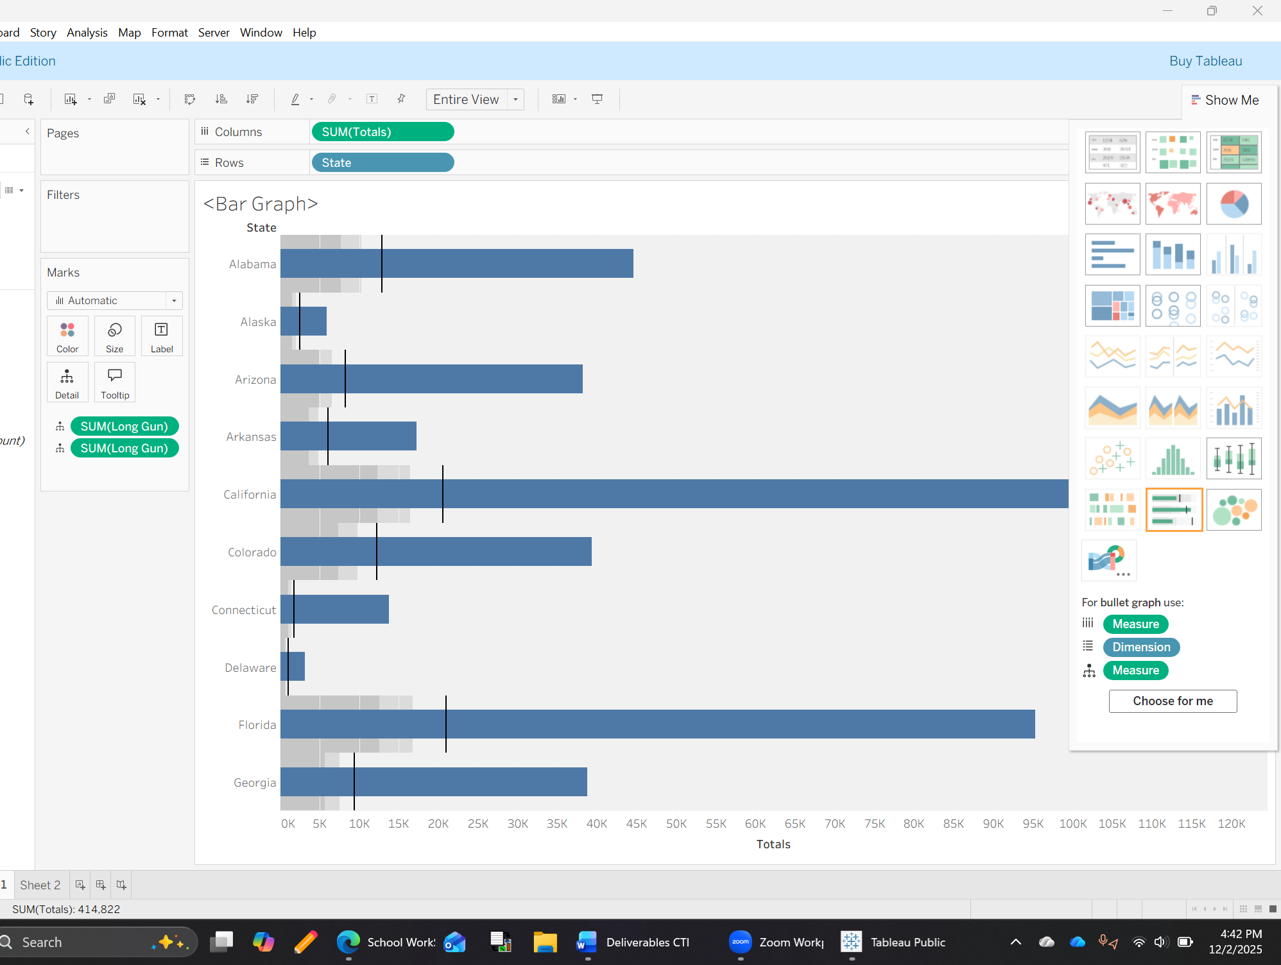
Tableau plots
This bar graph was made in Tableau using firearm data from September 2023. It shows the total number of firearm transactions for 10 states, with each bar representing one state. The bars are color-coded to show different types of transactions like handguns, long guns, permits, and others.
California has the highest total, followed by Florida and other states. The graph helps show which states had the most activity and what types of firearms were involved. It was built using Measure Names and Measure Values to stack the categories in each bar.
-Collins Onokala Bar Chart

Slide 19
Conclusion
This project showed how powerful data visualizations are when analyzing large datasets. Instead of searching through hundreds or thousands of rows, charts make patterns appear instantly. Bar charts help compare categories quickly, pie charts show proportions briefly, histograms reveal the shape of a distribution, and scatter plots make relationships between variables easy to spot. Visualizations transform raw data into information that can be interpreted in seconds, which is why they are essential tools in data analysis

Slide 20
References
2023 ACS PUMS DATA DICTIONARY (2024, October 17) UnitedSatesCensus.gov https://www2.census.gov/programs-surveys/acs/tech_docs/pums/data_dict/PUMS
BuzzFeed News. (2023). NICS Firearm Background Checks [Data set]. GitHub. Retrieved from https://raw.githubusercontent.com/BuzzFeedNews/nics-firearm-background-checks/refs/heads/master/data/nics-firearm-background-checks.csv

